Slide 1
Communal data harmonization initiative for researchers using CBS microdata
Bastian Ravesteijn & Mirthe Hendriks Erasmus School of Economics
Notes:
Welcome everybody to this presentation on a communal data harmonization initiative for researchers using CBS microdata.

Slide 2


Children and (future) Parents, supported by Prediction and Professionals in Prevention, to improve Opportunity (C-4PO)
NWA: Big data en kansrijke start
Notes:
I [Mirthe] work as a junior data analyst on the project Children and (future) Parents, supported by Prediction and Professionals in Prevention, to improve Opportunity or C-4PO. This project is financed by ZonMw as a part of the Dutch Research Agenda programme ‘Big data en kansrijke start’. In this project I work on the big data analysis using machine learning techniques, so I spend a lot of my time looking at CBS microdata.

Slide 3

Initiative data harmonization
Community-based
Easier, less time-consuming
Openly accessible GitHub
Notes:
Today I would like to talk to you about a community-based initiative for researchers working with CBS microdata in the remote access environment. The motivation behind this initiative is to facilitate easier, less time-consuming data harmonization, particularly to optimize the combining (or joining) of different CBS microdata files. How, by making data harmonization scripts openly accessible through GitHub.
I just want to mention that we are in the early stages of developing this initiative, so I hope to receive your input and suggestions on how to develop this more in the future.

Slide 4
Big data and data harmonization
Data harmonization: the effort of combining data from different sources and integrating them into a single cohesive dataset
unavoidable but time-consuming
Notes:
One thing that we have noticed with the rise of Big data research, is that to work with these large amounts of data we often have to combine various data sources.
Well, first let’s define data harmonization. Data harmonization refers to the effort of combining data from different sources with varying file locations, file formats, and naming conventions, and transforming it into a single cohesive data set.
For researchers using the CBS microdata, data harmonization is an unavoidable but time-consuming part the data analysis process. (Maybe you are familiar with the “80/20 rule” in data science: the reality that 80 percent of valuable time is spent simply finding, cleansing, and organizing data, and only 20 percent of time is used to actually perform analysis. Luckily, for those of us who use the CBS microdata, CBS does most of the preprocessing for us. But still, data harmonization – i.e. combining various microdata files into one coherent dataset – takes a lot of time.)
I am wondering, who here (in the audience) works with the CBS microdata in the remote access environment? Then you might be familiar with some of the challenges I will discuss.

Slide 5


Why is data harmonization of CBS microdata files challenging?
Many different microdata files
Different folders and subfolders
Changing file paths
Notes:
While the CBS microdata infrastructure facilitates ground-breaking research, it remains a challenge for researchers to manage the vast amount of datafiles, the documentation and to join the data. So, why is data harmonization of CBS microdata files challenging?
There are many different microdata files (I believe over 500) https://www.cbs.nl/-/media/cbs-op-maat/microdatabestanden/documents/overzicht-van-alle-bestanden/alle-beschikbare-catalogus-bestanden.pdf Available for different years
Second, there are even more file paths. You can find each microdata file in a folder, organized by file topic. In many cases, this folder will contain subfolders, a separate folder for each year. Here we see SPOLISBUS as an example. What if we want to look at this data on jobs and wages for multiple years, from 2010 up and until 2022, we need to combine the data sets in these separate folders, which all have different file paths.
In addition, names of the microdata files in these subfolders might change, as newer versions become available. V1 might become V2 and even V5.
When you are working with the data you read multiple microdata files, and you use the file paths in your code. What happens when these file paths change or when files are moved, your code will not run, and you will have to change the file paths everywhere.

Slide 6
Observations recorded at different moments
TAB
BUS
Naming conventions
Variable availability per year
RINPERSOONS | RINPERSOON | OPLNR
RINPERSOONS | RINPERSOON | AANVBUS | EINDBUS | SECM
R | 01234567 | 01-06-2003 | 31-12-2006 | 11
R | 01234567 | 01-01-2007 | 01-10-2011 | 15
ZVWKEERSTELIJNSPSYCHO | ZVWKGENBASGGZ
srtnummoeder | rinpersoons_moeder
OPLNIVSOI2016AGG4HBMETNIRWO | OPLNIVSOI2021AGG4HBmetNIRWO
Notes:
4. Another challenge is that The CBS microdata files you want to use in your research might have a different structure; recording observation at different moments. There are the TAB files where one row constitutes one person for who an observation is recorded for this specific year. And there are BUS files where, we don’t have one observation by year, these files record the observation for a certain period, so with a start date and end date as observed per month.
What do we do when we want to combine a TAB and a BUS file?
5. Another reason why data harmonization is challenging is the naming conventions of variables within the CBS microdata files. Variable names might change over time, we see some examples here.
In ZVWZORGKOSTENTAB ZVWKEERSTELIJNSPSYCHO after 2013 is ZVWKGENBASGGZ
In PRNL srtnummoeder from 2008 on is rinpersoons_moeder
And in HOOGSTEOPLTAB OPLNIVSOI2016AGG4HBMETNIRWO is changed to OPLNIVSOI2021AGG4HBmetNIRWO from 2019 on
If a researcher wants to use these variables over the years, they will have to rename them for consistency and to bind them in one column.
6. Moreover, there are variables that are available for some years, not for all. To get a comprehensive understanding of the microdata researchers need to thoroughly study the documentation.

Slide 7
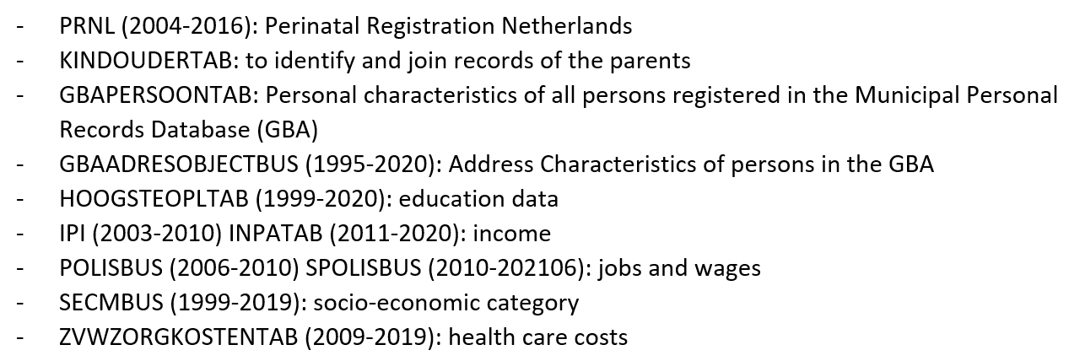
‘Harmonization-scripts’ for C-4PO
Project Children and (future) Parents, supported by Prediction and Professionals in Prevention, to improve Opportunity
R-scripts openly accessible through GitHub: https://github.com/MMJHendriks/HarmonizationScripts_CBSmicrodata
Notes:
Currently, most CBS microdata-users – at least the ones I have spoken to – spend a considerable amount of time harmonizing the CBS microdata. Frequently they are working on (harmonizing) the same data, reinventing the wheel.
The ambition of this initiative is to share our work and encourage others to do the same, to be more efficient and learn from each other.
In the project Children and (future) Parents, supported by Prediction and Professionals in Prevention, to improve Opportunity we work with CBS microdata on child health and development, demographic variables and parental characteristics, such as income and social economic status. We have harmonized microdata of about 10 data files ;
PRNL (2004-2016): Perinatal Registration Netherlands
KINDOUDERTAB: to identify and join records of the parents
GBAPERSOONTAB: Personal characteristics of all persons registered in the Municipal Personal Records Database (GBA)
GBAADRESOBJECTBUS (1995-2020): Address Characteristics of persons in the GBA
HOOGSTEOPLTAB (1999-2020): education data
IPI (2003-2010) INPATAB (2011-2020): income
POLISBUS (2006-2010) SPOLISBUS (2010-202106): jobs and wages
SECMBUS (1999-2019): socio-economic category
ZVWZORGKOSTENTAB (2009-2019): health care costs
We have made the R scripts openly accessible through GitHub. The intention is that other CBS microdata-users can use these ‘harmonization-scripts’; run the scripts in the RA-environment and easily extract the harmonized data of interest.
Let’s have a look at the GitHub page: https://github.com/MMJHendriks/HarmonizationScripts_CBSmicrodata
The GitHub repository consists of a README file that describes this data harmonization initiative and its intentions. Additionally, it contains folders with the harmonization scripts per project. You can find a folder named ‘C-4PO’, which contains the harmonization scripts created for this project. You can click on the folder and read the project description to find out what the project C-4PO is about and what harmonization scripts are available. There is also a folder labelled Example_project to show how other researchers with their own CBS project can simply create a new folder and upload the harmonization scripts they created.

Slide 8
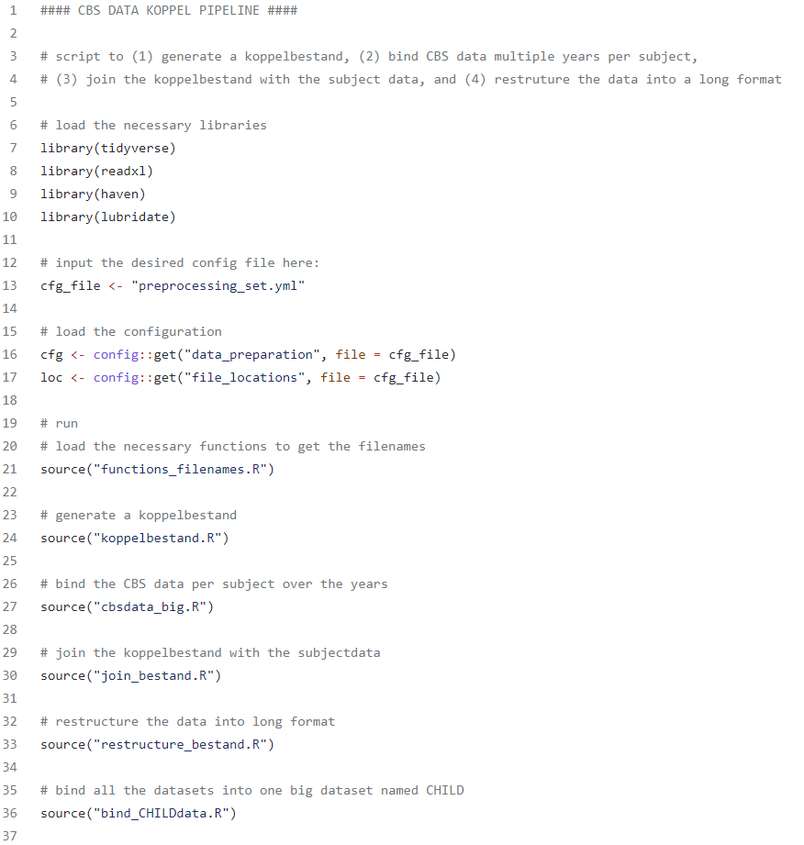
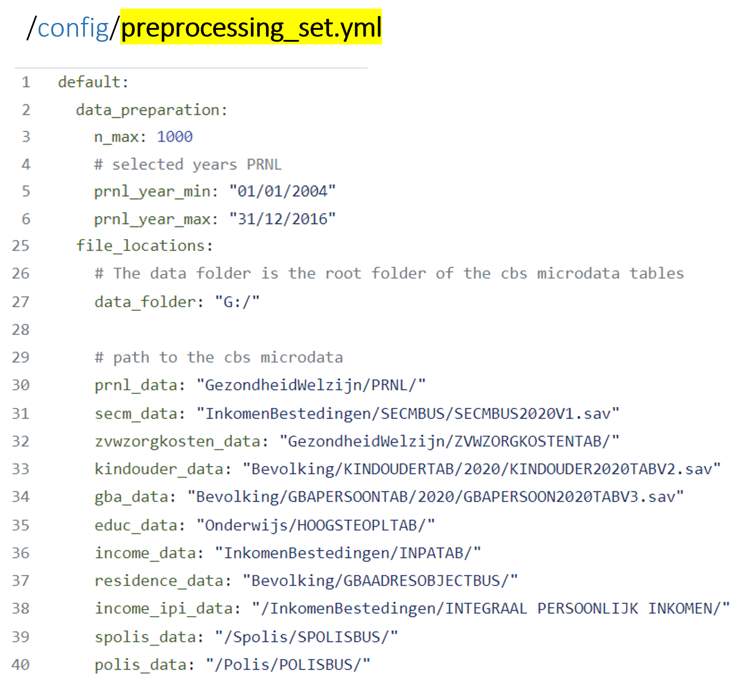
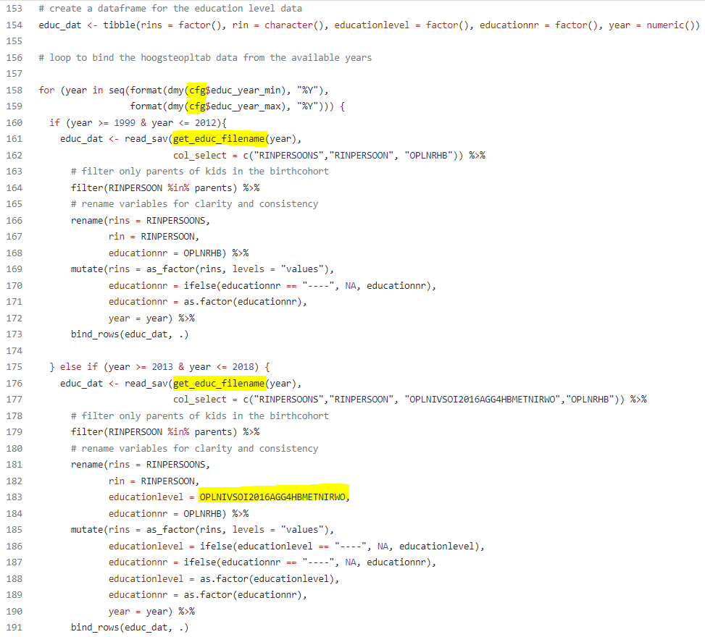
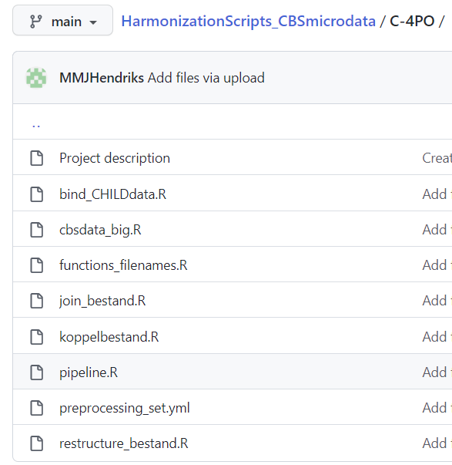
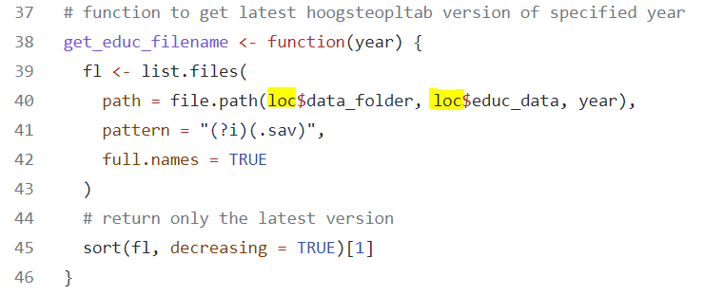


Notes:
I want to zoom in on some of the things you can find in the harmonization scripts on the GitHub page. One of the available scripts is named Pipeline.R, and this pipeline can be used to run all the harmonization scrips in one time, to generate a ready to use dataset. The code here runs the harmonization scripts (with source) available on the GitHub page. This data set is of course created for this project, for C-4PO. But, if you are working on a very different project with different data these harmonization scripts might still be useful. Some of the code was written to deal with the challenges mentioned ealier (e.g. the different folders, subfolders and file paths).
We for example have all filepaths in one location (top right). Which we store in loc (middle left).
There is a function to automatically get the most recent file paths for the specified year (bottom right). Here we use loc$datafolder and loc$educ_dat to refer to the file path.
If the file path changes we only have to update our one document with all file locations, instead of having to change every file path in the code.
Now we can simply use this loop (bottom left) to get the education data for the specified years and bind the files together.
This might be a lot of information and a lot of code, especially if you are not familiar with R. However, my intention is to show you that you can use these harmonization scripts as inspiration for how to solve your own (data) harmonization challenges.

Slide 9
Community-based initiative publishing harmonization-scripts
Benefits
Optimizing reproducability to reduce time-consuming work
Improving efficiency
Increasing visibility of harmonization efforts
Promote Open Science and FAIR principles
Stimulate researchers working with CBS microdata to cooperate
Notes:
I have made our data harmonization scripts openly accessible. But as I mentioned before, there are over 500 microdata files in the CBS RA-environment. Unfortunately I cannot do this for all the CBS microdata files.
Therefore, we would like to encourage other researchers working with CBS microdata to publish harmonization-scripts on this GitHub repository.
This community-based initiative provides a range of benefits: increasing visibility of harmonization efforts, optimizing reproducibility to reduce time-consuming work, and improving efficiency. Not only does this initiative promote the implementation of Open Science and FAIR principles, it might also stimulate researchers working with CBS microdata to cooperate.
More info:
Open Science is the movement that aims at more open and collaborative research practices in which publications, data, software and other types of academic output are shared at the earliest possible stage and made available for reuse. Open Science leads to greater scientific and societal impact.
To improve the Findability, Accessibility, Interoperability, and Reuse of digital assets (In 2016, the ‘FAIR Guiding Principles for scientific data management and stewardship’ were published in Scientific Data). The principles refer to three types of entities: data (or any digital object), metadata (information about that digital object), and infrastructure.

Slide 10





Call to action!
Now
Publish harmonization scripts on GitHub
Jan 2023
Action plan with early adoptors
Spring 2023
Get feedback from researchers using CBS microdata
and more …
Notes:
So this is a call to action:
I want to ask you to Publish your harmonization scripts on the GitHub repository.
As I mentioned, we are in the early stages of developing this initiative, so I hope to receive your feedback and input.
In januari of 2023, I would like to organise a meeting for those who are interested, to develop a action plan for this initiative with early adoptors (to discuss how to formalize the initiaive, with regards to issues, folder structure, coding conventions, etc. and to get an impression of what the community needs.)
At a later stage, we plan to reach out to researchers using the CBS microdata to receive their feedback and suggestions on how to futher improve the GitHub repository.
And hopefully this initiative will prove useful/helpful.

Slide 11

Questions
Would you use these harmonization scrips?
Would you publish your own harmonization scripts on GitHub?
Contact: m.m.j.hendriks@ese.eur.nl
www.linkedin.com/in/mirthe-hendriks
Notes:
Questions:
Do you think this is useful? Would you use these scripts yourself? Why/ why not?
If you have these types of harmonization scripts, would you publish them on this GitHub page? So they are openly accessible to other researchers using the CBS microdata
What would be helpful? What would you hope other people post on this GitHub?

